Slide 1
Linked List
Unit - 2

Slide 2
Single Linked List
Circular Linked List
Double Linked List
Circular Double Linked List
Applications of Linked List
Sparse Matrix Representation and its performance analysis
Addition of Polynomials and its performance analysis

Slide 3
Linked Lists: Single linked lists
List is a finite, ordered sequence of data items known as elements.
“Ordered” in this definition means that each element has a position in the list.
In other words, there is a first element in the list, a second element, and so on.
Each list element also has a data type.
Formally, a general list is of the form a1, a2, a3, ..., an. We say that the size of this list is n.
We will call the special list of size 0 a null list

Slide 4
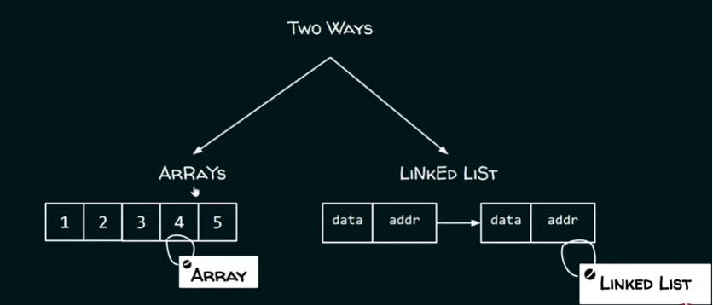

Slide 5
Limitations of Arrays
Fixed size: The size of an array is fixed. With a little extra effort, by dynamically allocating an array in the heap.
Wastages of space: If the number of elements in an array is less than the size of the array, which is fixed in advance, then it leads to wastage of space.
Sequential storage: An array allocates memory for all its elements chunked together as one block of memory. For arrays, contiguous space is required.
Possibility of overflow: If the program ever needs to process more than the size, there is a possibility of overflow and the code breaks.
Difficulty in insertion and deletion: Inserting new elements at the front cannot be efficiently done because existing elements need to be shifted to make room. Similar is the case for deletion also.

Slide 6
An appropriate solution to these problems is the linked list, which, at some cost in memory space, permits lists to be constructed and modified easily.
A linked list is a sequence of elements in which every element has link to its next element in the sequence.
Such an element is known as the node of a linked list.
Both the array and the linked list are alternative implementation options for a sequence which is a collection of items with a defined order

Slide 7


Slide 8
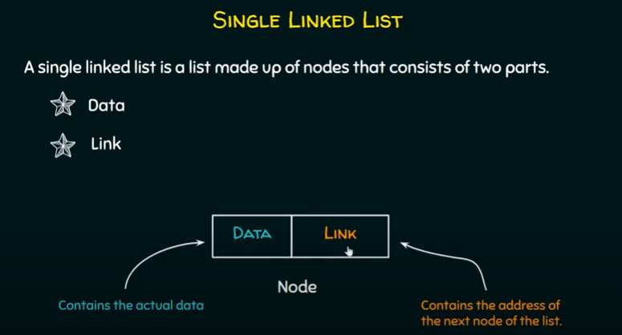

Slide 9
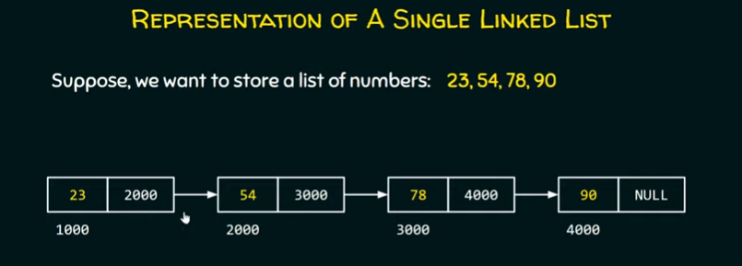
Address of next node data

Slide 10
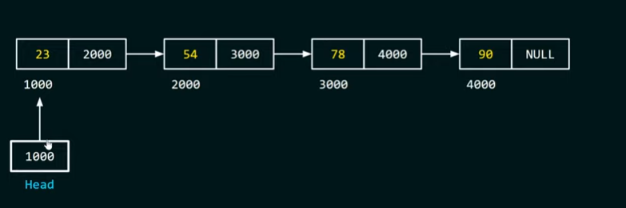
How to access the first node of Linked List?
To access first node of linked list, create a head pointer.
Assign the address of first node to head.

Slide 11

Array vs. Single Linked List (In Terms of Representation)

Slide 12
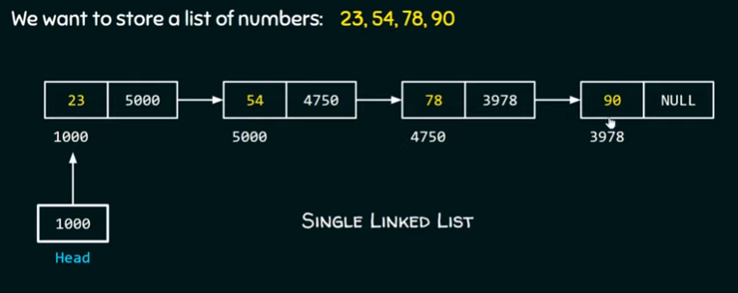


Slide 13
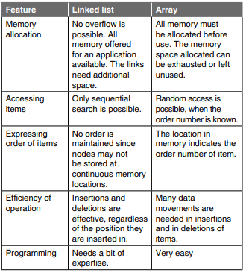

Slide 14

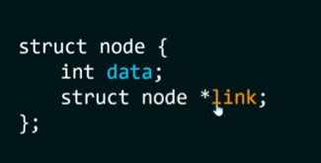
Creating the Node of a Single Linked List
Node is nothing but a structure.
Link points to a struct node. (next node)
Self referential structure
Hence, node is a self referential structure in C.

Slide 15
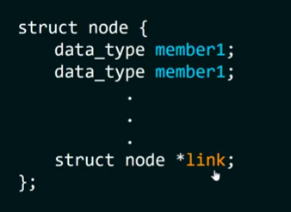

Slide 16
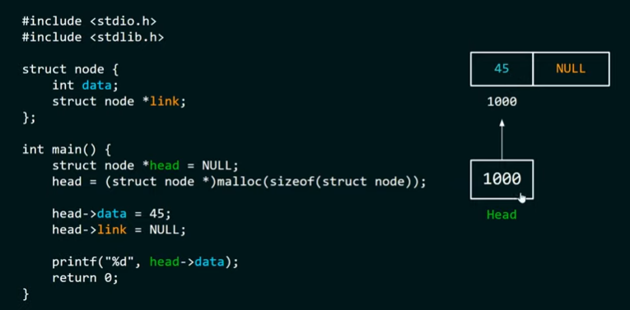
Output: 45

Slide 17
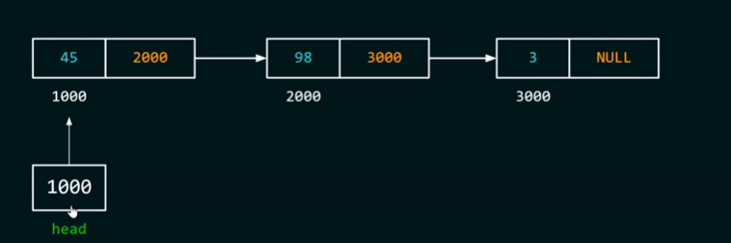
Creating a Single Linked List

Slide 18
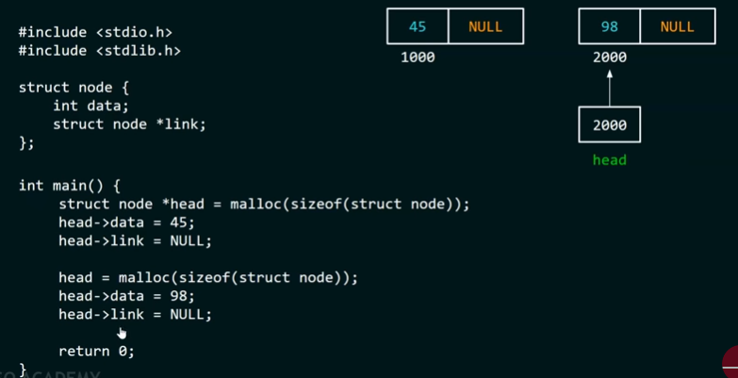

Slide 19
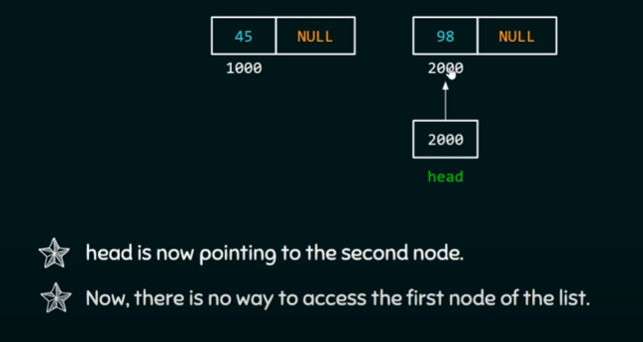

Slide 20
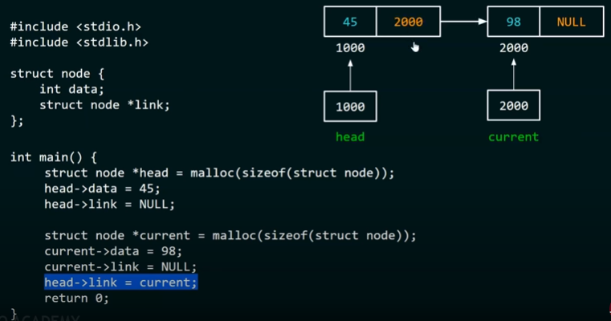

Slide 21
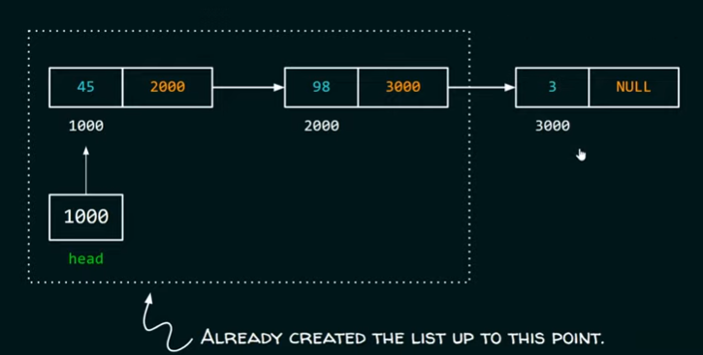

Slide 22
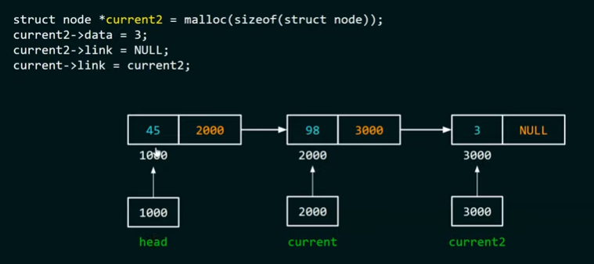

Head->link=>2000

Slide 23
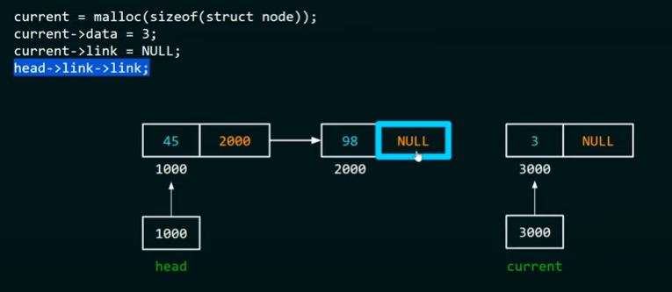

Slide 24
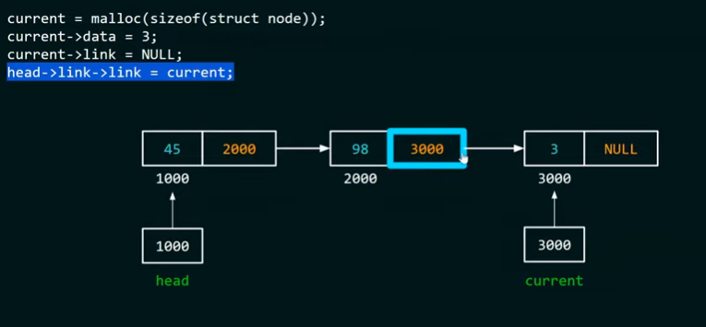

Slide 25
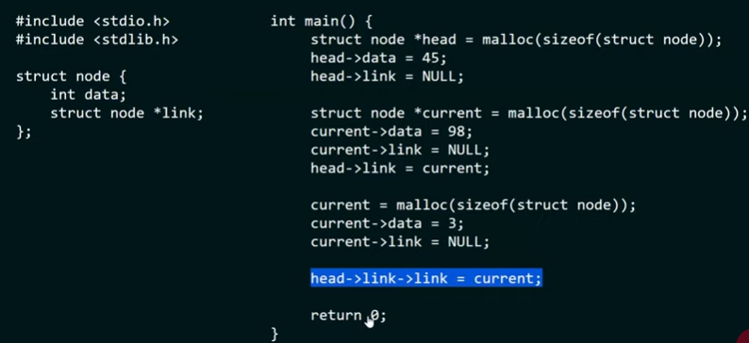

Slide 26
Linked List Operations: Traverse, Insert and Delete
There are various linked list operations that allow us to perform different actions on linked lists.
For example, the insertion operation adds a new element to the linked list.
Here's a list of basic linked list operations:
Traversal - access each element of the linked list
Insertion - adds a new element to the linked list
Deletion - removes the existing elements
Search - find a node in the linked list
Sort - sort the nodes of the linked list

Slide 27
Traverse a Linked List
Displaying the contents of a linked list is very simple.
We keep moving the temp node to the next one and display its contents.
When temp is NULL, we know that we have reached the end of the linked list so we get out of the while loop.
struct node *temp = head;
printf("\n\nList elements are - \n");
while(temp != NULL) {
printf("%d --->",temp->data);
temp = temp->link;
}
List elements are -
1 --->2 --->3 --->

Slide 28
Insert Elements to a Linked List
You can add elements to either the beginning, middle or end of the linked list.
1. Insert at the beginning
Allocate memory for new node
Store data
Change next of new node to point to head
Change head to point to recently created node
struct node *newNode;
newNode = malloc(sizeof(struct node));
newNode->data = 4;
newNode->link = head;
head = newNode;

Slide 29
2. Insert at the End
Allocate memory for new node
Store data
Traverse to last node
Change next of last node to recently created node
struct node *newNode;
newNode = malloc(sizeof(struct node));
newNode->data = 4;
newNode->link = NULL;
struct node *temp = head;
while(temp->link != NULL){
temp = temp->link;
}
temp->link = newNode;

Slide 30
3. Insert at the Middle
Allocate memory and store data for new node
Traverse to node just before the required position of new node
Change next pointers to include new node in between
struct node *newNode;
newNode = malloc(sizeof(struct node));
newNode->data = 4;
struct node *temp = head;
for(int i=2; i < position; i++) {
if(temp->link != NULL) {
temp = temp->link;
}
}
newNode->link = temp->link;
temp->link = newNode;

Slide 31
Delete from a Linked List
You can delete either from the beginning, end or from a particular position.
1. Delete from beginning
Point head to the second node
head = head->link;
2. Delete from end
Traverse to second last element
Change its next pointer to null
struct node* temp = head;
while(temp->link->link!=NULL){
temp = temp->link->link;
}
temp->link = NULL;

Slide 32
3. Delete from middle
Traverse to element before the element to be deleted
Change next pointers to exclude the node from the chain
for(int i=2; i< position; i++) {
if(temp->link!=NULL) {
temp = temp->link;
}
}
temp->link = temp->link->link;

Slide 33
search an element
To search an element in a Linked List, we need to traverse the entire Linked List.
Compare each node with the data to be search and continue until a match is found.
Begin the search process from the first node as random access is not possible in a Linked List.
struct node *temp = head; // Initialize current
while (temp!= NULL)
{
if (temp->data == x)
return true;
temp = temp->link;
}
return false;

Slide 34
sort the elements
Define a node current which will point to head.
Define another node index which will point to node next to current.
Compare data of current and index node.
If current's data is greater than the index's data then, swap the data between them.
Current will point to current->link and index will point to index->link.
Continue this process until the entire list is sorted.

Slide 35
int t;
Struct node *t1, *t2; //t1 – current node, t2 – index node
for(t1=head;t1->link!=NULL;t1=t1->link)
{
for(t2=head;t2->link!=NULL;t2=t2->link)
{
if(t2->data > t2->link->data)
{
t=t2->data;
t2->data=t2->link->data;
t2->link->data=t;
}
}
}

Slide 36

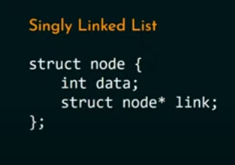
Doubly Linked List
A doubly linked list is a type of linked list in which each node consists of 3 components:
*prev - address of the previous node
data - data item
*next - address of next node
struct node {
int data;
struct node *next;
struct node *prev;
}

Slide 37

Representation of Doubly Linked List

Slide 38
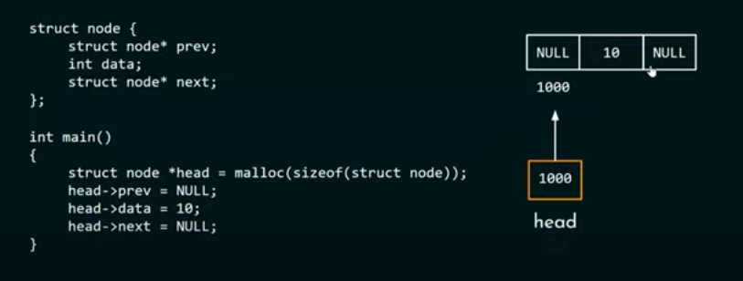

Slide 39
Operations on Double Linked List
Traversal
Insertion
Deletion
search

Slide 40
Traversal
void display()
{
if(head == NULL)
printf("\nList is Empty!!!");
else
{
struct Node *temp = head;
printf("\nList elements are: \n");
printf("NULL <--- ");
while(temp -> next != NULL)
{
printf("%d <===> ",temp -> data);
}
printf("%d ---> NULL", temp -> data);
}
}

Slide 41
Insertion on a Doubly Linked List
Insertion at the beginning
Insertion in-between nodes
Insertion at the End

Slide 42
Insertion at the Beginning
Step 1 - Create a newNode with given value and newNode → previous as NULL.
Step 2 - Check whether list is Empty (head == NULL)
Step 3 - If it is Empty then, assign NULL to newNode → next and newNode to head.
Step 4 - If it is not Empty then, assign head to newNode → next and newNode to head.

Slide 43
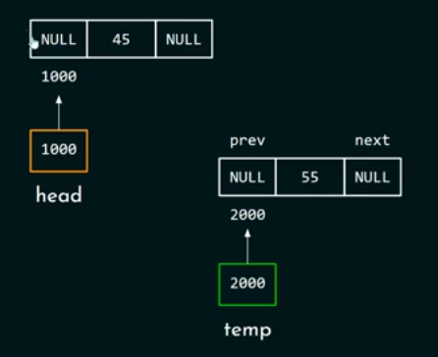

Slide 44
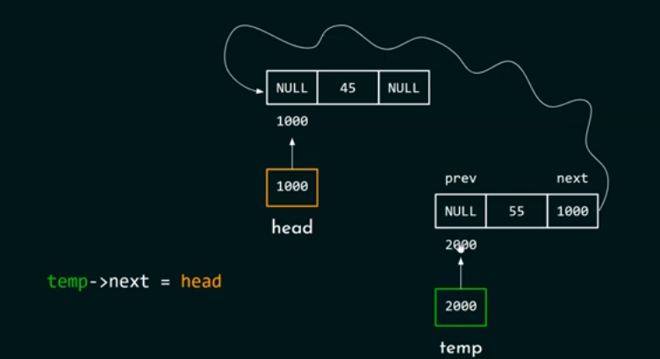

Slide 45
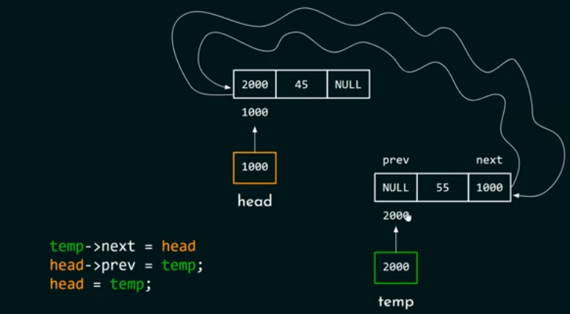

Slide 46
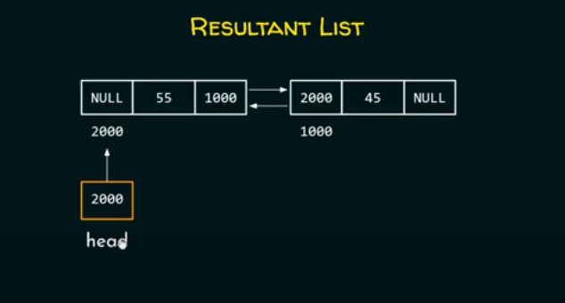

Slide 47
// insert node at the front
void insertFront(struct Node* head, int data) {
// allocate memory for newNode
struct Node* temp = (struct Node*) malloc(sizeof(struct Node));
// assign data to newNode
newNode ->data = data;
// point next of newNode to the first node of the doubly linked list
newNode ->next = head;
// point prev to NULL
newNode ->prev = NULL;
// point previous of the first node (now first node is the second node) to newNode
if (head != NULL)
head->prev = newNode;
// head points to newNode
head = newNode;
}

Slide 48
Insertion between the Nodes
Step 1 - Create a newNode with given value.
Step 2 - Check whether list is Empty (head == NULL)
Step 3 - If it is Empty then, assign NULL to both newNode → previous & newNode → next and set newNode to head.
Step 4 - If it is not Empty then, define two node pointers temp1 & temp2 and initialize temp1 with head.
Step 5 - Keep moving the temp1 to its next node until it reaches to the node after which we want to insert the newNode (until temp1 → data is equal to location, here location is the node value after which we want to insert the newNode).
Step 6 - Every time check whether temp1 is reached to the last node. If it is reached to the last node then display 'Given node is not found in the list!!! Insertion not possible!!!' and terminate the function. Otherwise move the temp1 to next node.
Step 7 - Assign temp1 → next to temp2, newNode to temp1 → next, temp1 to newNode → previous, temp2 to newNode → next and newNode to temp2 → previous.

Slide 49
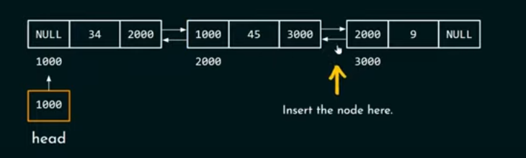

Slide 50
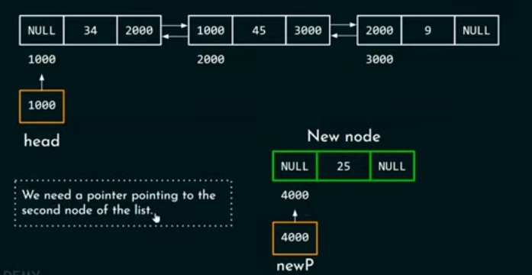

Slide 51
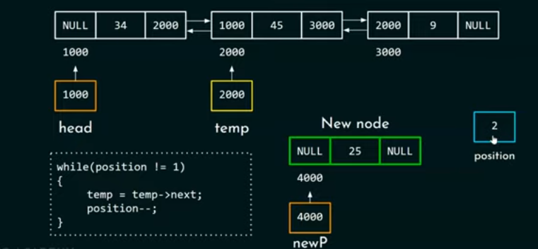

Slide 52
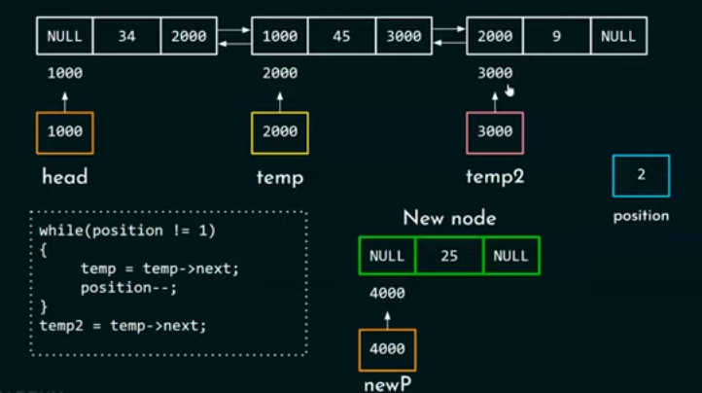

Slide 53
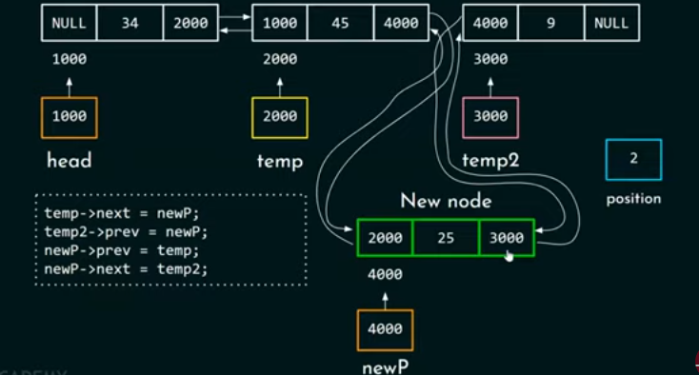

Slide 54
/* Given a node as prev_node, insert a new node after the given node */
void insertAfter(struct Node* prev_node, int new_data)
{
/*1. check if the given prev_node is NULL */
if (prev_node == NULL) {
printf("the given previous node cannot be NULL");
return;
}
/* 2. allocate new node */
struct Node* new_node = (struct Node*)malloc(sizeof(struct Node));
/* 3. put in the data */
new_node->data = new_data;
/* 4. Make next of new node as next of prev_node */
new_node->next = prev_node->next;
/* 5. Make the next of prev_node as new_node */
prev_node->next = new_node;
/* 6. Make prev_node as previous of new_node */
new_node->prev = prev_node;
/* 7. Change previous of new_node's next node */
if (new_node->next != NULL)
new_node->next->prev = new_node;
}

Slide 55
Inserting At End
Step 1 - Create a newNode with given value and newNode → next as NULL.
Step 2 - Check whether list is Empty (head == NULL)
Step 3 - If it is Empty, then assign NULL to newNode → previous and newNode to head.
Step 4 - If it is not Empty, then, define a node pointer temp and initialize with head.
Step 5 - Keep moving the temp to its next node until it reaches to the last node in the list (until temp → next is equal to NULL).
Step 6 - Assign newNode to temp → next and temp to newNode → previous.

Slide 56
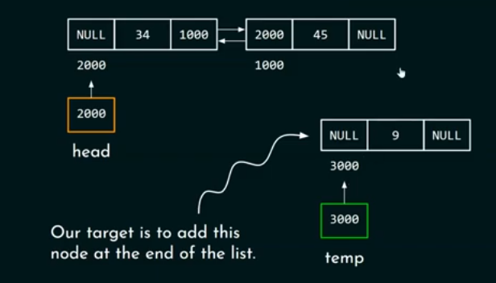

Slide 57
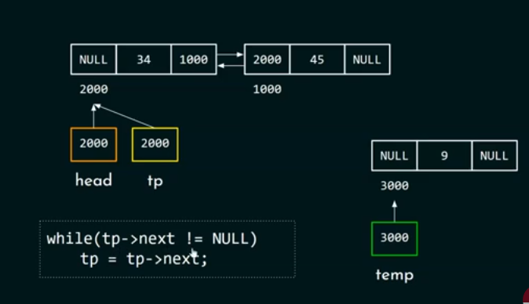

Slide 58
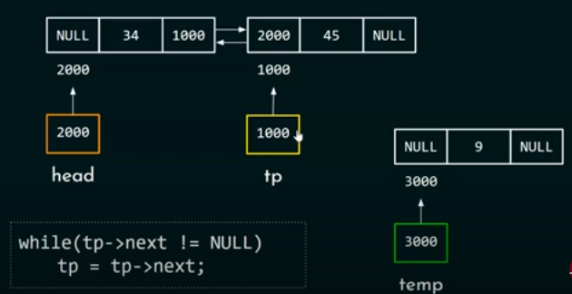

Slide 59
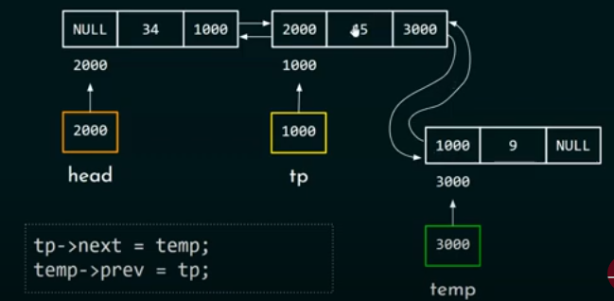

Slide 60
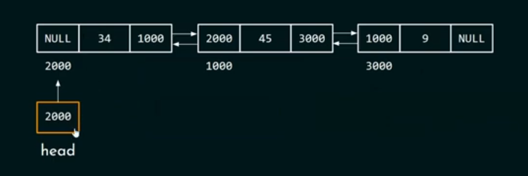

Slide 61
/* Given a reference (pointer to pointer) to the head
of a DLL and an int, appends a new node at the end */
void append(struct Node* head, int new_data)
{
/* 1. allocate node */
struct Node* new_node = (struct Node*)malloc(sizeof(struct Node));
struct Node* last = head; /* used in step 5*/
/* 2. put in the data */
new_node->data = new_data;
/* 3. This new node is going to be the last node, so
make next of it as NULL*/
new_node->next = NULL;
/* 4. If the Linked List is empty, then make the new
node as head */
if (head == NULL) {
new_node->prev = NULL;
head = new_node;
return;
}
/* 5. Else traverse till the last node */
while (last->next != NULL)
last = last->next;
/* 6. Change the next of last node */
last->next = new_node;
/* 7. Make last node as previous of new node */
new_node->prev = last;
return;
}

Slide 62
Applications
Linked Lists can be used to implement Stacks , Queues.
Linked Lists can also be used to implement Graphs. (Adjacency list representation of Graph).
A polynomial can be represented in an array or in a linked list by simply storing the coefficient and exponent of each term.
However, for any polynomial operation , such as addition or multiplication of polynomials , linked list representation is more easier to deal with.
Linked lists are useful for dynamic memory allocation.
The real life application where the circular linked list is used is our Personal Computers, where multiple applications are running.
All the running applications are kept in a circular linked list and the OS gives a fixed time slot to all for running. The Operating System keeps on iterating over the linked list until all the applications are completed.

